Slide 1


Subject Code: SIT-1610
Subject Name: Social Network Analysis
Faculty Name: Dr.L.Mary Gladence

Slide 2
Syllabus
UNIT 1 INTRODUCTION 9 Hrs.
Introduction to Semantic Web: Limitations of current Web - Development of Semantic Web - Emergence of the Social Web
Social Network Analysis: Social Networks Perspective - Analysis of Network Data - Interpretation of Network Data - Social Network Analysis in the Social and Behavioral Sciences - Metrics in social network analysis.

Slide 3
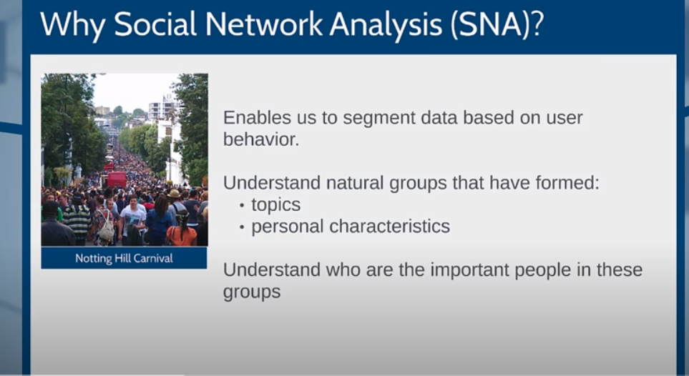

Slide 4
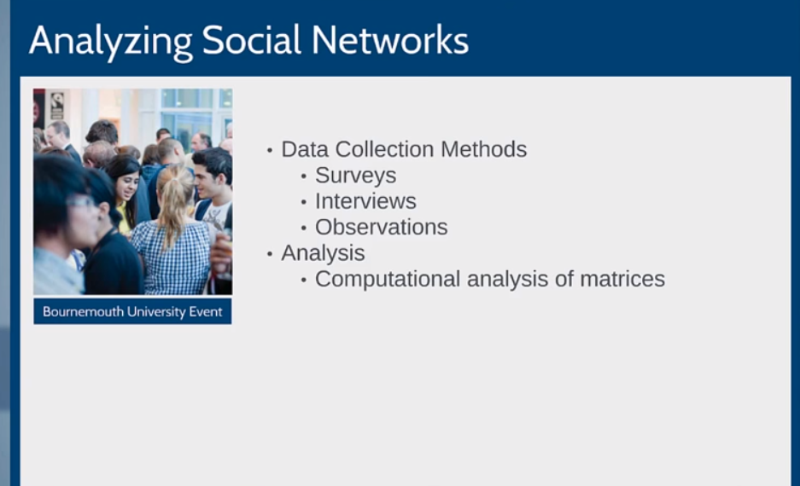

Slide 5
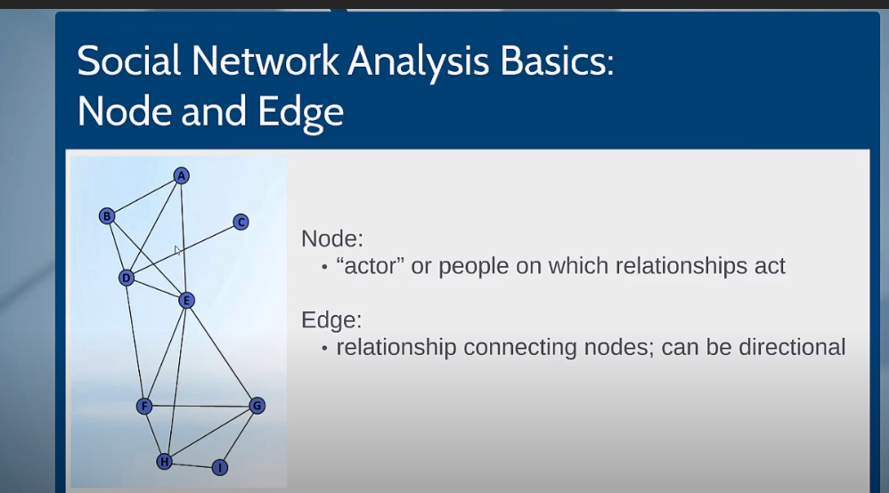

Slide 6
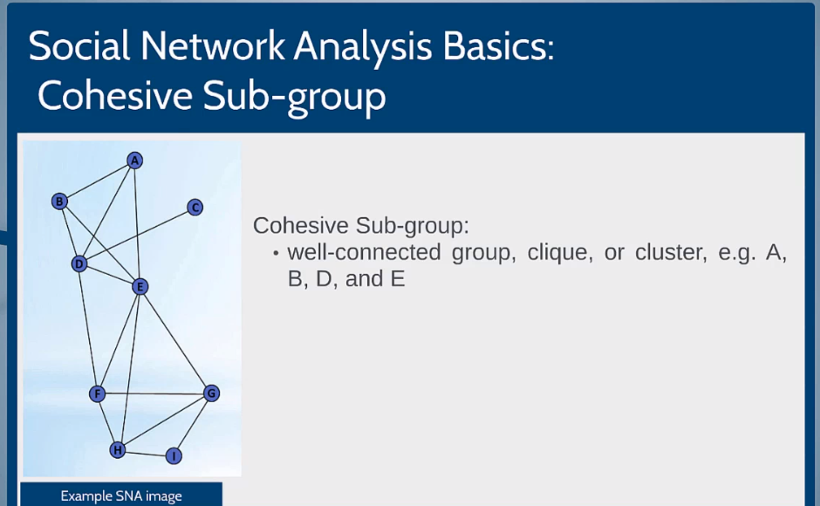

Slide 7
Social network analysis (SNA) is the process of investigating social structures through the use of networks and graph theory. It characterizes networked structures in terms of nodes (individual actors, people, or things within the network) and the ties, edges, or links (relationships or interactions) that connect them.
Social network analysis (SNA) can provide insight into social influences within teams, and identify cultural issues.
The research conducted for SNA is interested in individuals, but the analysis itself focuses on connectivity: how individuals collaborate.
SNA has been used as a strategic approach to team building, and to understand how team building can change the dynamics of an organisation’s social network.

Slide 8
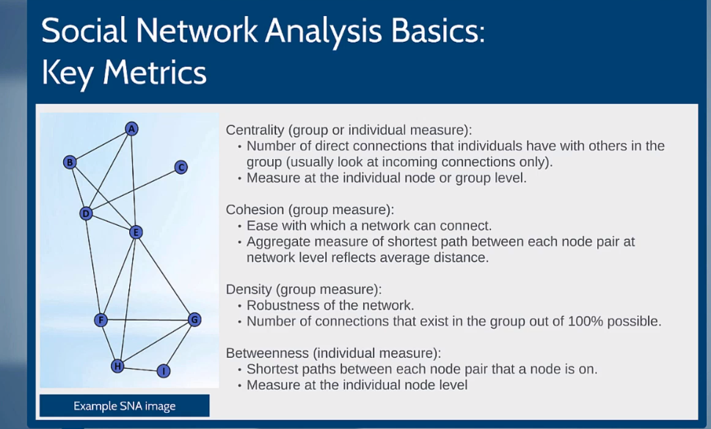

Slide 9
Social Web
The social web is a set of social relations that link people through the World Wide Web.
Websites and software are designed and developed in order to support and foster social interaction
Online shopping education, gaming and social networking
The term "social Web" was coined by Howard Rheingold

Slide 10
Examples of Social networking
Blogs and wikis
Mobile connectivity support
Social features added to non-social sites eg:allrecipes.com
Social art
Crowdsourcing:eg. SurveyMonkey.com
Community-based software projects
Mobile application development

Slide 11
Social Network Analysis
Social network analysis (SNA) is the process of investigating social structures through the use of networks and graph theory.
G=(V,E)
V=(individual actors, people, or things within the network)
E=relationships or interactions
For the sake of simplicity, we will concentrate on social networks showing only the presence (1) or absence (0) of the relationship.

Slide 12
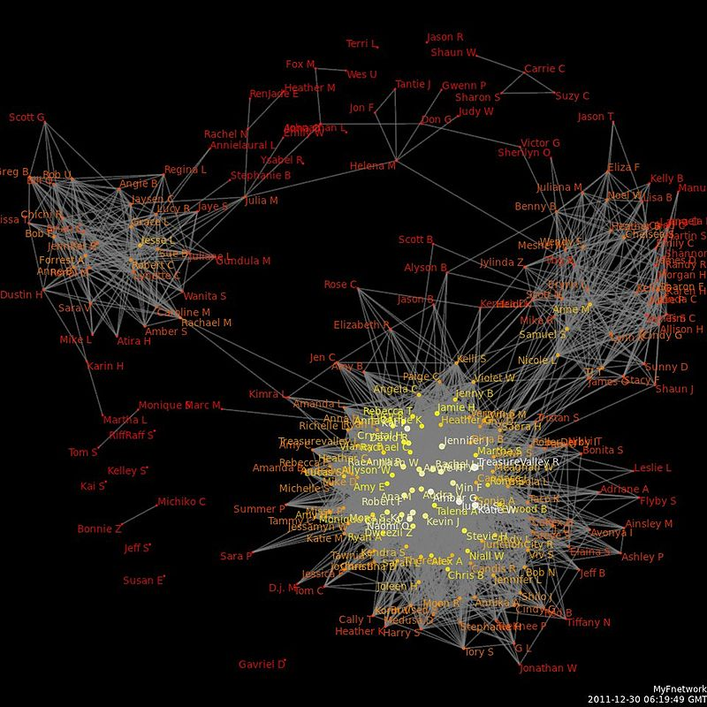
A social network diagram displaying friendship ties among a set of Facebook users

Slide 13
Types of Social Networks
Social media networks
Memes spread
Friendship and acquaintance networks
Collaboration graphs
Kinship
Disease transmission
Other relationships.

Slide 14
Perspectives of Social Networks
Consumer
Youth
Friendship
Identity
Predator
Bullying
Reassurance
Genre
Branding
Network
Love
Source Critique
Sincerity
Democratic
Materialistic
Language
Public
Surveillance
Group work
Time consuming
Social
Anti Social
Generation gap
Learning

Slide 15
Analysis of Network Data
E Book Link:
https://books.google.co.in/books?hl=en&lr=&id=4Ty5xP_KcpAC&oi=fnd&pg=PR9&dq=analysis+of+social+network+data&ots=9NHJzftaBZ&sig=hLWWWaAeGRmnJK2StpV_pAQ58xI#v=onepage&q=analysis%20of%20social%20network%20data&f=false

Slide 16
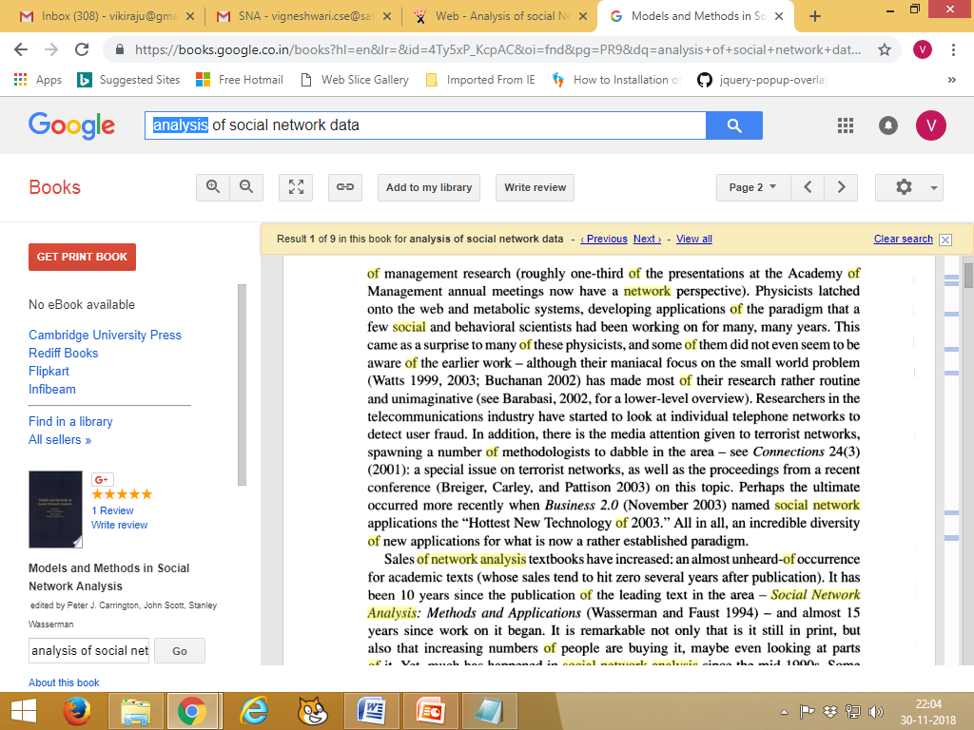
Social Web

Slide 17
Social Network Concept
Social network refers to the articulation of a social relationship
Positive relationships are only considered
Units of a social network:
individuals, families, households, and rural or urban areas
Relationship: Binary/Dyadic
Direction of flow: Symmetric/Asymmetric
Social networking is the use of internet-based social media platforms to stay connected with friends, family, or peers. The most popular social networking sites in the U.S. include Facebook, Instagram, and Twitter

Slide 18
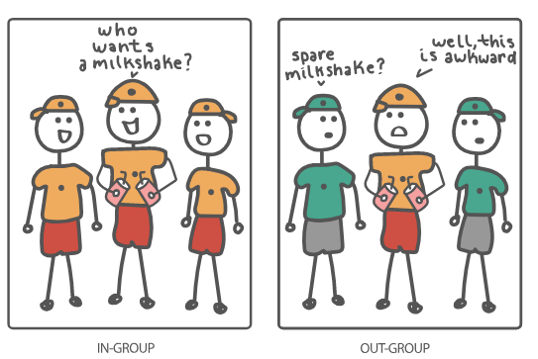
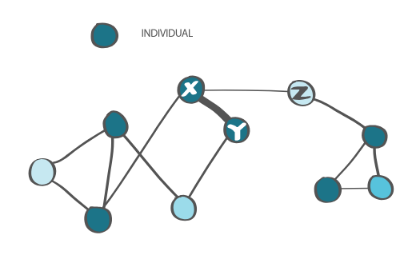
Social Group Vs Social Network
Social Network
Social Group

Slide 19
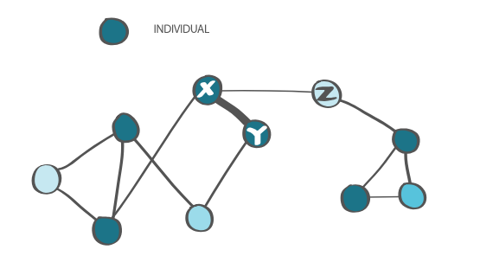
Differentiating Social Ties
Node Tie

Slide 20
Homophily
social network, homophily means that individuals with similar traits are more likely to form social ties with one another, which also often impacts their actions.

Slide 21
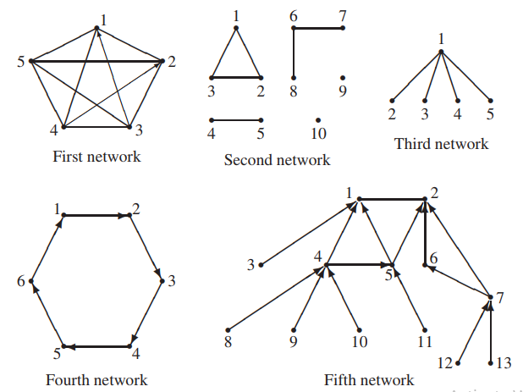
SN Models

Slide 22
SN Density
N=No. of Vertices
M=No. of Ties
Density Range->(0-1)
The third basic parameter of a social network is the number of reciprocal (also called symmetric or mutual) pairs in it. This is the number s of unordered pairs of vertices {u, v} such that both uv and vu are ties in the network.

Slide 23
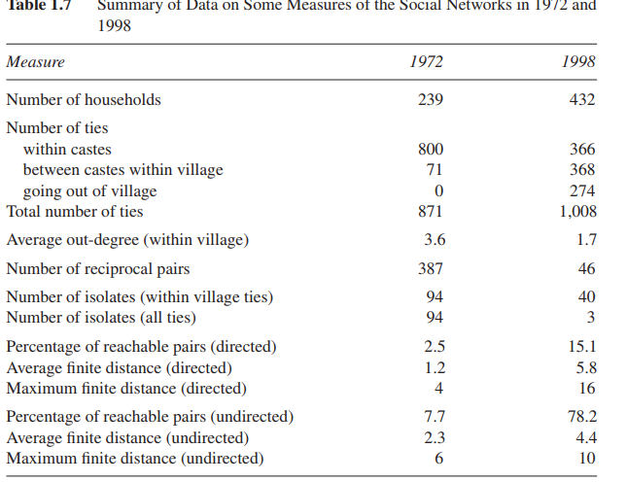
Case Study of the same village in different time periods

